Slide 1

Chapter 7 Supervised Machine Learning
Main Resource: Artificial Intelligence Foundations of Computational Agents David L. Poole and Alan K Mackworth, Cambridge University Press.

Slide 2
Overview
The ability to learn is essential to an intelligent agent.
Learning is the ability of an agent to improve its behavior based on experience:
The range of behaviors is expanded; the agent can do more.
The accuracy of tasks is improved; the agent can do things better.
The speed is improved; the agent can do things faster.
This section considers the problem of supervised learning:
Supervised learning has a set of training examples (dataset with input-output pairs) that predict the output of a new example (a new input not in the training data set).

Slide 3
Learning Issues
The following components are part of any learning problem:
Task: The behavior or task that is being improved
Data: The experiences (a set of numerical values) that are used to improve performance in the task in the form of a sequence of examples
Measure of improvement: How is learning efficiency measured?
For example, can new skills not present in training data increase accuracy in prediction?

Slide 4
Learning Issues - Task
The most commonly studied learning task is supervised learning:
From some input and target features, generate a set of training examples and predict the value of target features for a new example (with only input features).
This is called classification when the target features are discrete (target features are either true or false or yes or no)
and is called regression when the target features are continuous
For instance, finding whether a person has liver disease or not is discrete, but their weights are continuous

Slide 5
Learning Issues - Task
Other learning tasks include learning classifications when the examples do not have targets defined (called unsupervised learning)
Learning what to do based on rewards and punishments (called reinforcement learning)
Learning to reason faster (called analytic learning)
Learning representations such as logic programs (called inductive logic programming/learning)

Slide 6
Learning Issues - Feedback
Learning tasks can be characterized by the feedback given to the learner
In supervised learning, what has to be learned is specified for each example:
Supervised classification occurs when a trainer provides the classification for each example.
Supervised learning occurs when the agent is given immediate feedback about the value of each action.
Unsupervised learning occurs when no classifications are given
The learner must discover the classification/categories and regularities within the data.

Slide 7
Learning Issues - Representation
Experiences must affect the learning agent’s internal representation
This internal representation could be the raw experiences (a set of inputs) themselves
Inferring based on an internal representation is called induction, which derives the consequences from the agent knowledge base (KB).
Much of machine learning is studied in the context of particular representations and is supported by various algorithms (e.g., decision trees, neural networks, or case-based reasoning).

Slide 8
Learning Issues - Online and offline
In offline learning, all training examples are available to a learning agent before acting.
In online learning, training examples arrive as the agent starts acting
An agent that learns online requires some representation of its previous examples before seeing all of its models.
As new examples are observed, the agent must update its representation.
Active learning is a form of online learning in which the learning agent acts to acquire valuable examples from its learned data.

Slide 9
Learning Issues - Measuring success
Learning is defined in terms of improving performance based on some measures.
To know whether an agent has learned, we must define a measure of success.
The measure of success is usually not how well the agent performs on the training dataset (called seen data) but how well the agent acts for new or test data (also called unseen data).
In classification, measuring successes is not based on correctly classifying all training examples.
But it is based on correctly classifying the unseen data.

Slide 10
Learning Issues - Measuring success
The learner must generalize to classify the unseen examples.
A standard way to evaluate a learning procedure is to divide the examples into training examples and test examples
A representation is built using the training examples, and the predictive accuracy is measured on the test examples.
The test cases should not be known during training.

Slide 11
Learning Issues - Bias
The tendency to prefer one hypothesis over another is called a bias
For example, consider two agents, X and Y, and it is saying that a hypothesis is better than X’s or Y’s hypothesis
Both X and Y accurately predict all the data given – but it is something external to the data.
Without a bias value, an agent cannot predict unseen examples.

Slide 12
Learning Issues - Learning as search
Given a representation and a bias, the problem of learning can be reduced as a search:
Learning is a search through the space of possible representations, trying to find the representation or representations that best fit the data based on the bias value.
Nearly all search techniques used in machine learning can be seen as forms of local search through a space of data representations.
A machine learning algorithm’s definition includes the search space, the evaluation function, and the search method.

Slide 13
Supervised Learning
Supervised learning is based on a set of training examples (a set of input and target (output) features)
The aim is to predict the values of the target features from the input features.
A feature is a function from examples into a value: If e is an example, and F is a feature, F(e) is the value of feature F for the example e.
If e is an example of a training set, and F is a feature, Val (e, F) is the value of feature F in example e.
The domain of a feature is the set of values it can return.

Slide 14
Supervised Learning
In a supervised learning, the learner is given:
a set of input features, X₁, . . . , X_{n};
a set of target (output) features, Y₁, . . . , Y_{k};
a set of training examples, where the values for the input features and the target features are given for each example; and
a set of test examples where only the values for the input features (it is the untrained data called the unseen data) are given.
The aim is to predict the values of the target features for the unseen data.

Slide 15
Supervised Learning
Example 7.1: Figure 7.1 shows training and test examples of a classification task. The aim is to predict whether a person reads an article posted to a threaded discussion website or not
The input features are Author, Thread, Length, and WhereRead. There is only one target feature, UserAction.
The domain of Author is {known, unknown}, the domain of Thread is {new, followup}, and so on.
There are eighteen seen data (e₁,….,e₁₈).
In this dataset, Author(e₁₁)=unknown, Thread(e₁₁)= followUp, and UserAction(e₁₁) = skips.
There are two test examples, e₁₉ and e₂₀, where the userAction is unknown.
The aim is to predict the userAction for these two test examples.

Slide 16
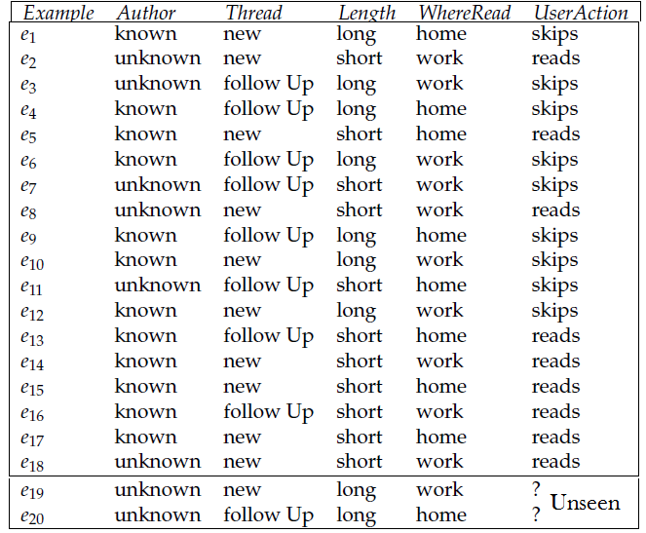
Figure 7.1: Examples of a user’s preferences

Slide 17
Supervised Learning
Example 7.2: Figure 7.2 shows some data for a linear regression task, where the aim is to predict the value of feature Y on examples for which the value of feature X is provided
This is a regression task because Y is a real-valued feature.
Predicting a value of Y, for example, e_{8,} is an interpolation problem, as its value for the input feature is between the values of the training examples.
Predicting a value of Y for the example e₉ is an extrapolation problem because its X value is outside the range of the training examples.

Slide 18
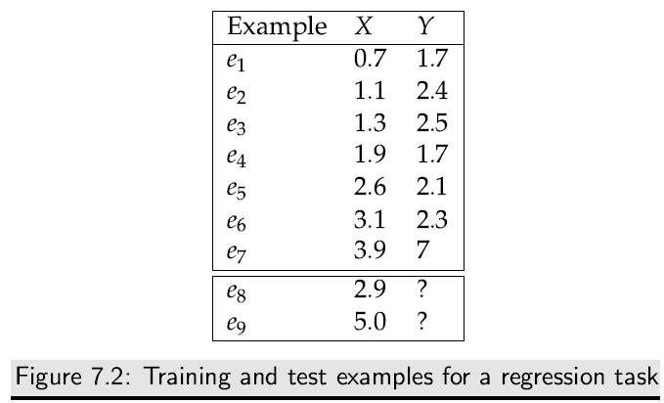
Supervised Learning

Slide 19
Evaluating Predictions
A point estimate for target feature Y on example e is a prediction of the value of Y(e) called the desired output.
Let Y’(e) be the predicted or calculated output for the same target feature on the example e.
The prediction error on this feature is a measure of how close each other, Es = Y(e) - Y’(e)
For regression, when the target feature Y is real-valued, Y’(e) and Y(e) are real numbers that can be compared arithmetically.
For classification, when the target feature Y is a discrete value, there are several alternatives.

Slide 20
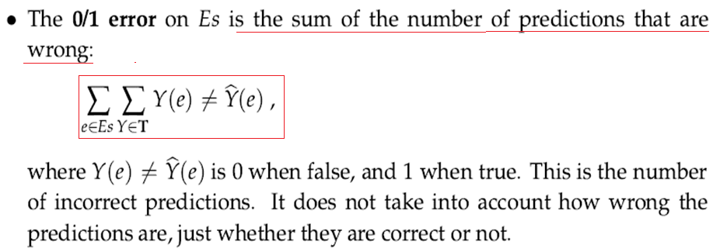
Evaluating Predictions
In the following measures of prediction error, Es is a set of examples, and T is a set of target features.
For target feature Y ∈ T and example e ∈ Es, the actual value is Y(e) and the predicted value is Y’(e).

Slide 21
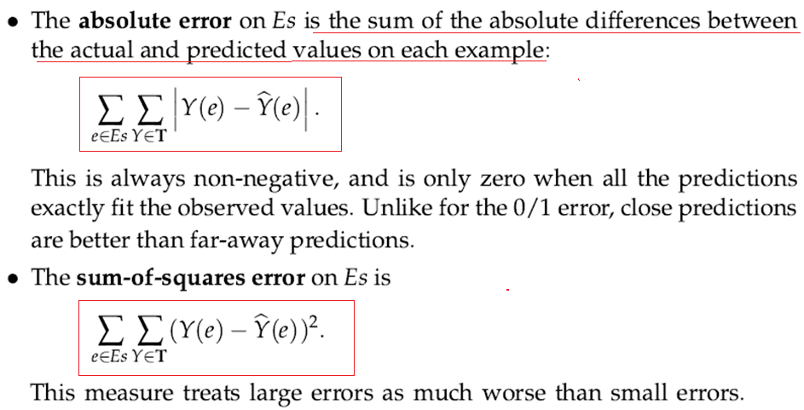
Evaluating Predictions

Slide 22
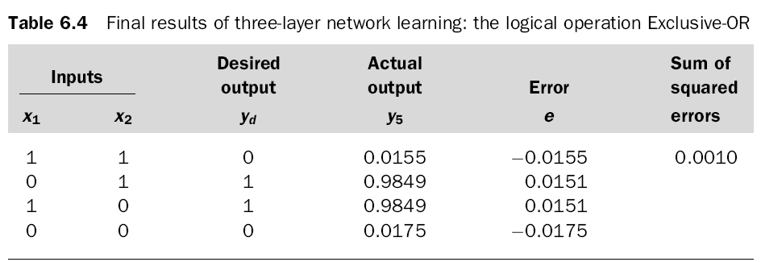
Evaluating Predictions
The sum-of-squares error (SOSE) example:

Slide 23
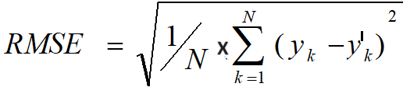
Evaluating Predictions
Minimizing the sum-of-squares error (SOSE) is equivalent to minimizing the Root-Mean-Square Error (RMSE) , obtained by dividing by the number of examples and taking the square root:
Where y_{k} is the actual output value, y is the calculated/predicted output value, and N is the total number of data samples

Slide 24
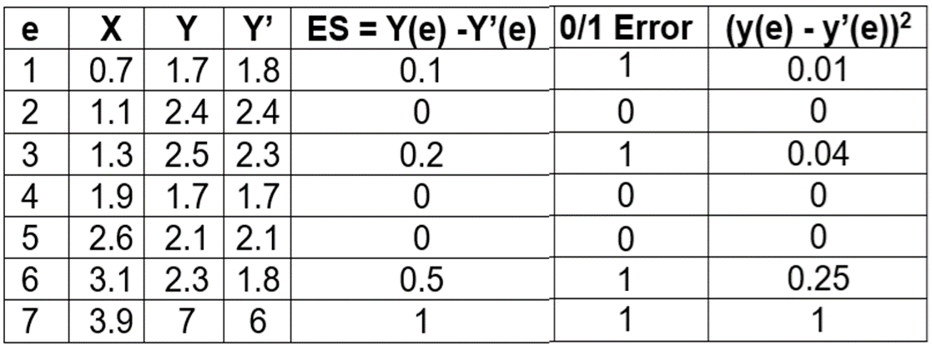
Evaluating Predictions
The results of the various average error value calculations of the linear regression data in Figure 7.2 are given below:
0/1 Error = 3
Absolute Error = 1.8
Sum-of-Square Error = 1.3
Root Mean Square Error = 0.431

Slide 25
Entropy
The entropy (Information) of the data is the number of bits it will take to encode the data given a code based on the predicted output Y’(e) is treated as a probability.
The entropy of Y’(e) is given as:
A better prediction is one with lower entropy.
A prediction that minimizes the entropy is a prediction that maximizes the likelihood.
Where Y(e) is the actual output of example e and Y’(e) is the predicted output of example e.

Slide 26
Entropy
To understand the notion of Information (Entropy), consider the following statement;
“whether a coin will come up heads” ⇒The amount of information contained in the answer depends on one’s prior knowledge
The information theory measures information content in bits; one bit of information is enough to answer a yes/no question about the flip of a fair coin
In general, if the possible answers v_{i} have probabilities P(v_{i}), then the information content I (or entropy) of the actual answer is:

Slide 27
Entropy
For a random variable x with probability p(x), the entropy H is the average (or expected) amount of information obtained by observing x:
H(x) = Σ_{x} p(x)I(x) = -Σ_{x} p(x)log₂p(x)
To check this equation, for the tossing of a fair coin ( both head and tail have an equal probability of 0.5 each), we get:
H(head) = I(0.5,0.5) = -0.5log₂(0.5) – 0.5log₂(0.5)= 1 {log₂(0.5) = −1
That results from each coin toss delivering one whole bit of information.

Slide 28
Entropy
However, if we know the coin toss is not fair, it comes up heads or tails with probabilities p and q, where p ≠ q. Every time it is tossed, one side is more likely to come up.
For example, if p = 0.7, then the entropy is:
H(head) = I(0.7, 0.3) = – 0.7log₂(0.7) – 0.3log₂(0.3)
= – 0.7 × (-0.515) – 0.3 × (– 1.737)
= 0.8816 < 1 (on average, each toss delivers less than one full bit of information)
How to calculate log₂(Y) if Y is not a 2^{n} value?
log₂(Y) = log(Y)/log(2) = log(Y)/0.30103
; where log(2) = 0.30103

Slide 29
Entropy
What entropy is getting a face six from a six-faced die?
H(6) = I(⅙, ⅙) = - ⅙ log₂ ⅙ - ⅙ log₂ ⅙ = 0.43087 + 0.43087 = 0.862 (each toss delivers less than one full bit of information)
What is the whole entropy of a four-sided (p1, p2, p3, and p4) die?
p1 =1/4 = 0.25, p2 = 0.25, p3 = 0.25 and p4 = 0.25
H(4-sided Die) =
= -0.25log₂0.25 - 0.25log₂0.25 - 0.25log₂0.25 - 0.25log₂0.25
= -[0.25log₂0.25 + 0.25log₂0.25 + 0.25log₂0.25 + 0.25log₂0.25]
= -[(0.25 * -1.999)+(0.25 * -1.999) +(0.25 * -1.999) +(0.25 * -1.999)]
= 1.99999 = 2 bits
What is the entropy of tossing a coin with a 99% head chance?

Slide 30
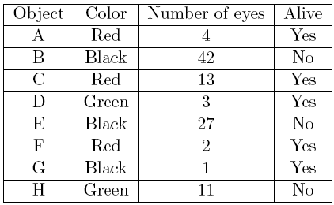
Entropy Calculation
Your spaceship has just landed on an alien planet, and your crew has begun investigating the local wildlife. Unfortunately, most of your scientific equipment is broken, so all you can tell about a given object is what color it is, how many eyes it has, and whether or not it is alive. To make matters worse, none of you are biologists, so you will have to use a decision tree to classify objects near your landing site as either alive or not alive.

Slide 31
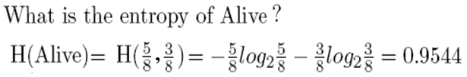
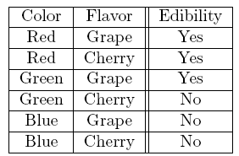
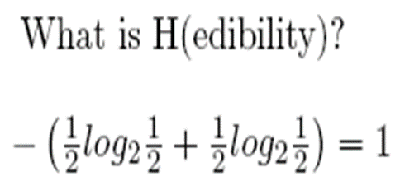
Entropy Calculation
2. A candy manufacturer interviews a customer on his willingness to eat a candy of a particular color or flavor. The following table shows the collected responses:
{ log₂5/8 = log₂ 0.625 = -0.6781
log₂3/8 = log₂0.375 = -1.415037}

Slide 32
Types of Learning Errors
Not all errors are equal; the consequences of some mistakes may be much worse than others.
For example, it may be much worse to predict that a patient does not have a disease; actually, the patient has a disease, so the patient does not get appropriate treatment
Similarly, it is predicted that a patient has a disease; the patient does not have it, forcing the patient to undergo further unwanted tests.
The learning agent should choose the best prediction according to the costs associated with the errors.

Slide 33
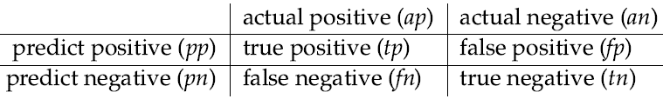
Types of Learning Errors
Consider a simple case where the domain of the target feature is Boolean (which we can consider as “positive” and “negative”), and the predictions are restricted to be Boolean.
One way to evaluate a prediction independently of the decision is to consider the four cases between the predicted value and the actual value:

Slide 34
Types of Learning Errors
A false-positive (f_{p}) error or type-I error is a wrong positive prediction (i.e., the predicted value is true, but the actual value is false).
false-negative (f_{n}) error or type-II error is a negative prediction that is wrong (i.e., the predicted value is false, but the actual value is true)
A predictor or predicting agent could claim a positive prediction, for example, when it is sure it is positive.
At the other extreme, it could claim a positive prediction for an example unless it is sure the example is negative.

Slide 35
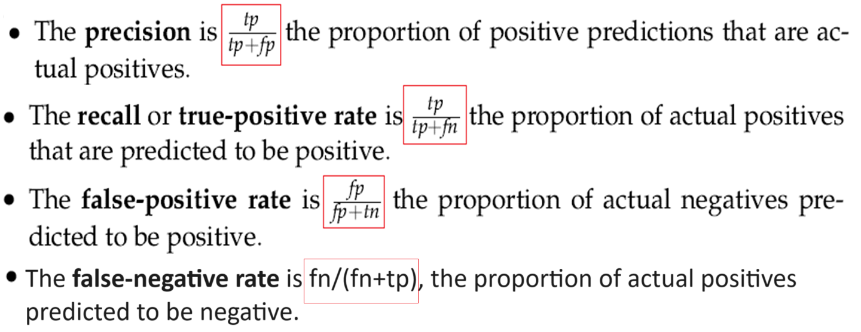
Types of Learning Errors
For a given predictor for a given set of examples, suppose t_{p} is the number of true positives, f_{p} is the number of false positives, f_{n} is the number of false negatives, and t_{n} is the number of true negatives. The following measures are often used:

Slide 36
Types of Learning Errors
A learning agent should try to maximize precision and recall
And minimize the false-positive rate and false-negative rate
however, these goals are incompatible.
An agent can maximize precision and minimize the false-positive rate by only making optimistic predictions about which it is sure.
However, this choice worsens recall.
To maximize recall, an agent can make predictions risky, making precision smaller and the false-positive rate larger.

Slide 37
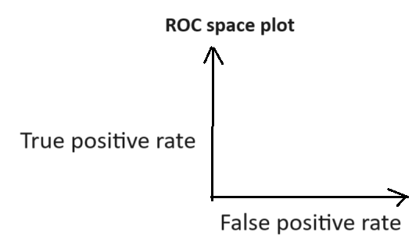
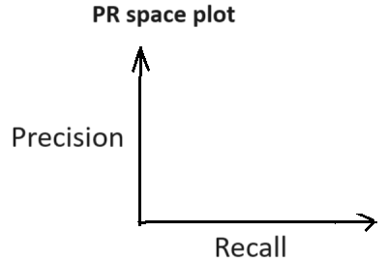
Types of Learning Errors
Receiver Operating Characteristic space plots (ROC space plots) map the false-positive rate (fp) against the true-positive rate (tp).
Each predictor for these examples becomes a point in the space.
A Precision-Recall (PR) space plot maps the precision against the recall.
Each approach may be used to compare learning algorithms independently of the actual costs of the prediction errors.

Slide 38
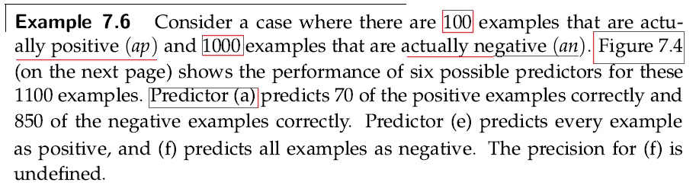
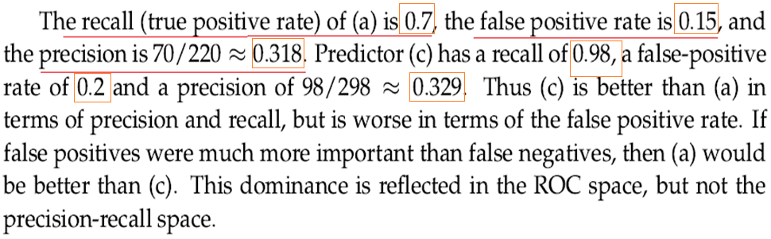

Slide 39
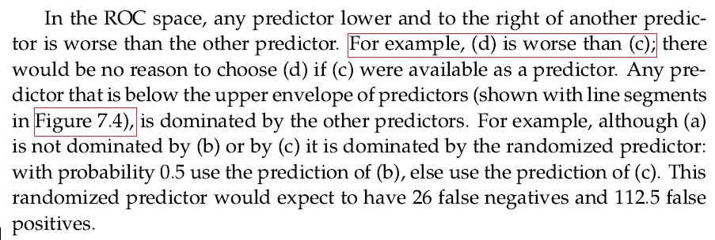
Types of Learning Errors

Slide 40
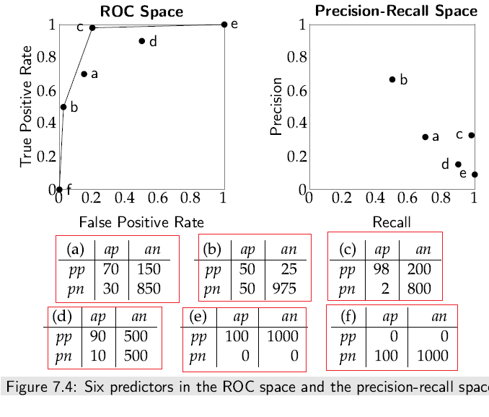

Slide 41
Learning Decision Trees
A decision tree is a simple representation for classifying examples.
Decision tree learning is one of the most straightforward techniques for supervised classification learning.
Assume there is a single discrete target feature called the classification. Each element of the domain of the classification is called a class.
A decision tree or a classification tree is a tree in which
each internal (non-leaf) node is labeled with a condition, a Boolean function of examples
each internal node has two children, one labeled with true and the other with false
each tree leaf is labeled with a point estimate on the class.
A decision tree corresponds to a nested if-else structure in a programming language.

Slide 42
Learning Decision Trees
To classify an example, filter it down the tree as follows:
The tree is constructed by recursively splitting the data into smaller subsets.
based on the feature that provides the most information gain (entropy).
The result is a tree with decision nodes and leaf nodes.
The decision nodes contain a question or a test on a feature.
The leaf nodes represent the final decision or the predicted outcome.

Slide 43
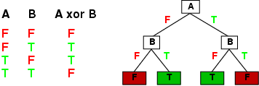
Learning Decision Trees
Decision trees can express any function of the input attributes.
E.g., for Boolean functions, truth table row → path to leaf:
Trivially, there is a consistent decision tree for any training set with one path to leaf for each example, but it probably won't generalize to new examples
Prefer to find more compact decision trees

Slide 44
Learning Decision Trees
The algorithm Decision tree learner of Figure 7.7 builds a decision tree from the top down as follows:
The input to the algorithm is a set of input conditions (Boolean functions of examples that use only input features),
target feature, and a set of training examples.
If the input features are Boolean, they can be used directly as the conditions.

Slide 45
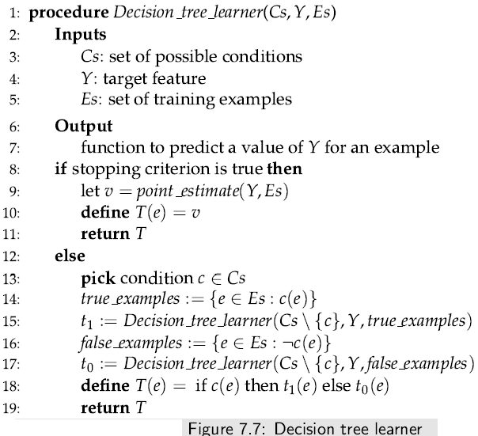

Slide 46
Figure 7.1: Examples of a user’s preferences

Slide 47
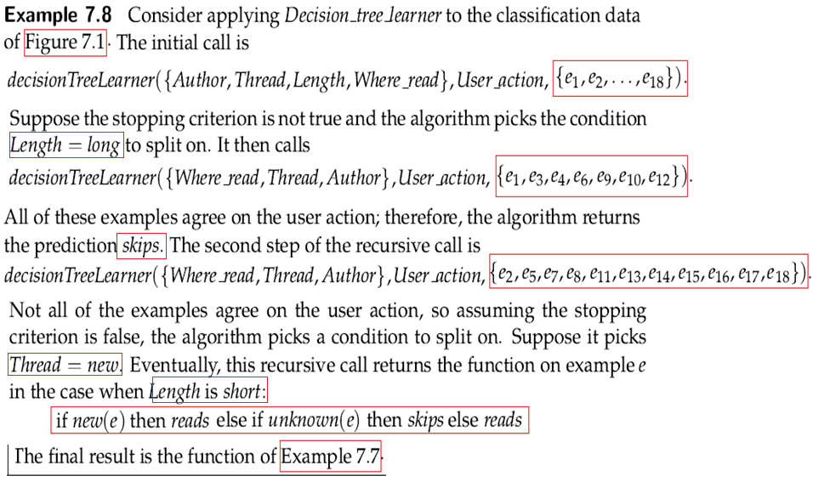

Slide 48
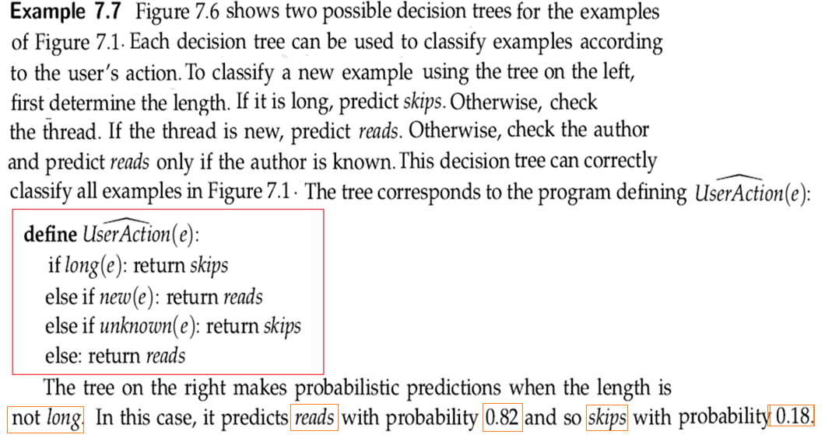

Slide 49
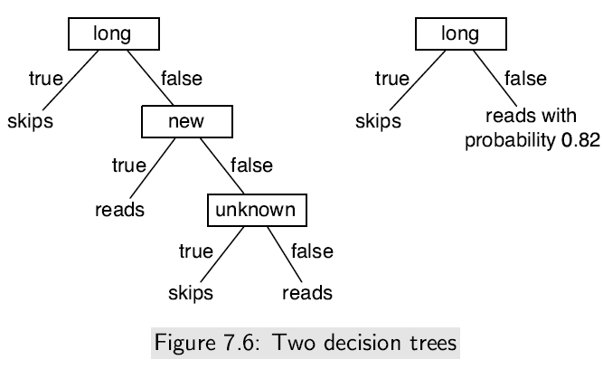
Learning Decision Trees

Slide 50
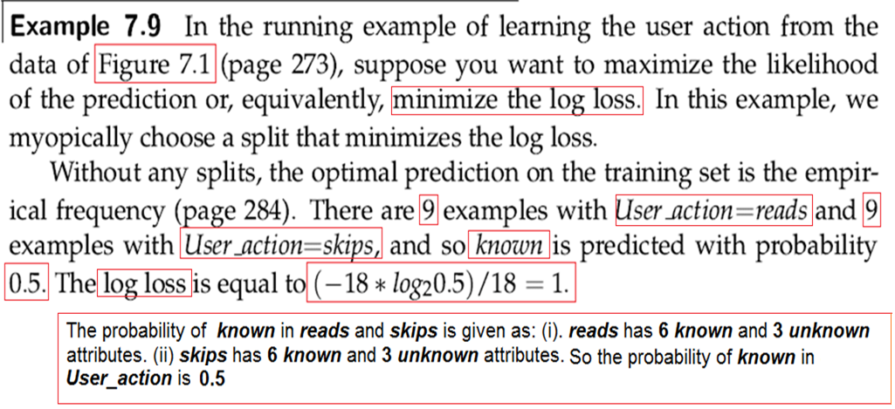
Learning Decision Trees

Slide 51
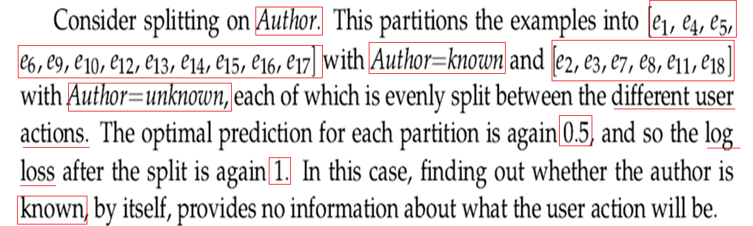
Learning Decision Trees

Slide 52
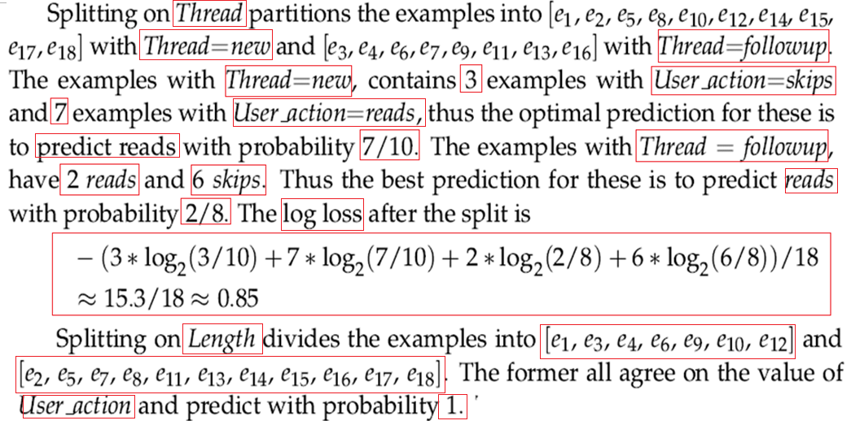
Learning Decision Trees

Slide 53
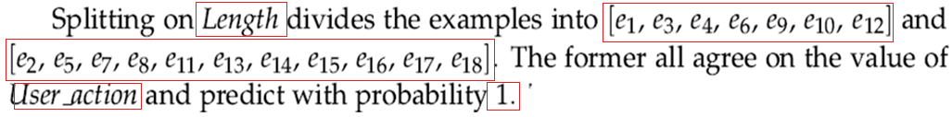
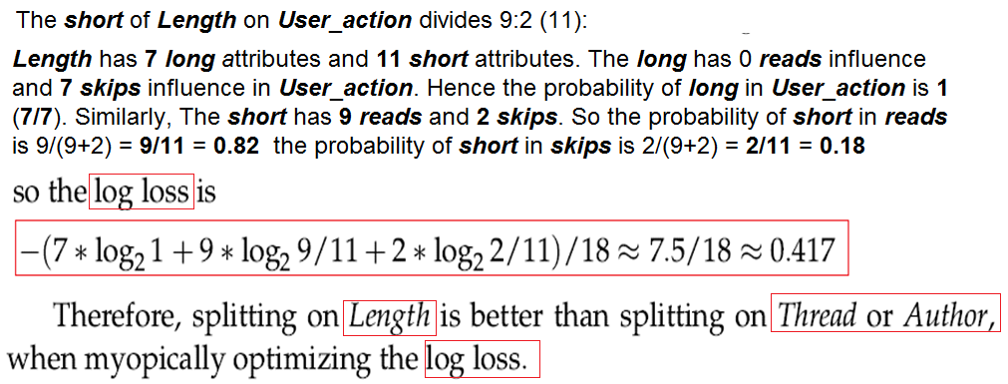
Learning Decision Trees

Slide 54
Figure 7.1: Examples of a user’s preferences

Slide 55
Learning Decision Trees
What is the log loss of splitting the input attribute WhereRead in UserAction?
Ans:
Splitting on WhereRead divides the examples in UserAction into home → (4 skips) and (4 reads).
Similarly, work → (5 skips) and (5 reads).
Therefore, 4 combinations of entropy values can be calculated.

Slide 56
Learning Decision Trees
(i). 4 x log₂(probability of home in UserAction attribute skips) = 4 x log₂ (4 skips)/(4 skips + 4 reads) = 4x log₂0.5
(ii). 4 x log₂ (probability of home in UserAction attribute reads)
= 4 x log₂ (4 reads)/(4 reads+ 4 skips) = 4x log₂0.5
(iii). 5 x log₂ (probability of work in UserAction attribute skips)
= 5 x log₂ (5 skips)/(5 reads+ 5 skips) = 5x log₂0.5
(iv). 5 x log₂ (probability of work in UserAction attribute reads)
= 5 x log₂ (5 reads)/(5 reads+ 5 skips) = 5x log₂0.5
So the log loss = -(4x log₂0.5+4x log₂0.5+ 5x log₂0.5 + 5x log₂0.5)/18
Where log₂ 0.5 =-1
So the log loss = (4 + 4 + 5 + 5)/18 = 1

Slide 57
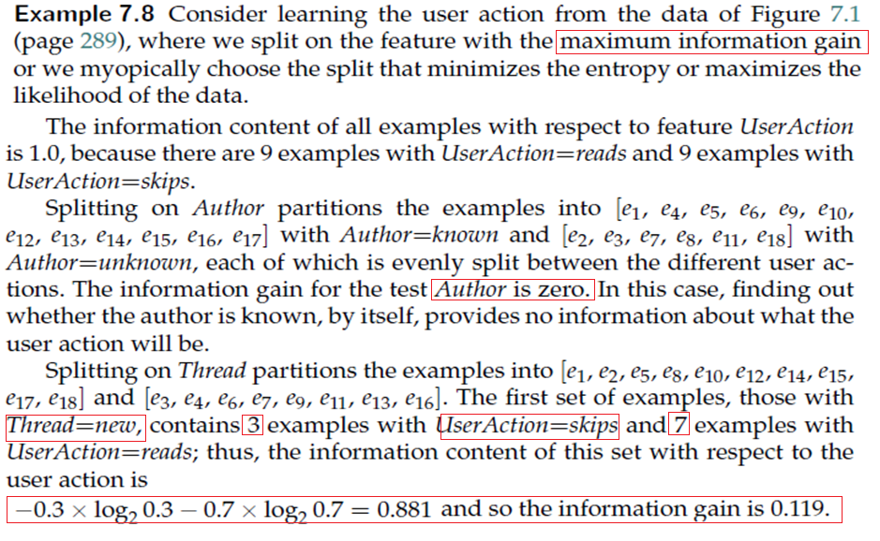

Slide 58
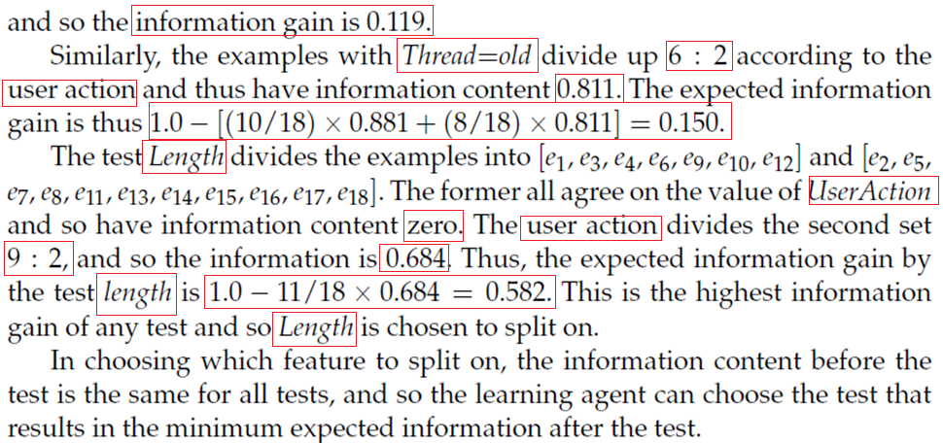
Learning Decision Trees

Slide 59
Expansion of Linear Regression for ML
Linear regression functions provide the basis for Machine Learning algorithms
A linear function is a function whose graph is a straight line
That is a polynomial function of degree 1 or 0.
When the linear function has only one variable, it is f(x) = ax + b, where b is a constant.
The function f(x) can be modified to handle a finite set of independent variables as (x₁,…, x_{k}):
f(x) = f(x₁,…, x_{k}) = a₁x₁ + a₂x₂ + ………..+ a_{k}x_{k} + b, and the graph is a hyper-plane of dimension k.
In geometry, a hyper-plane is a subspace whose dimension is one less than that of its ambient space.

Slide 60
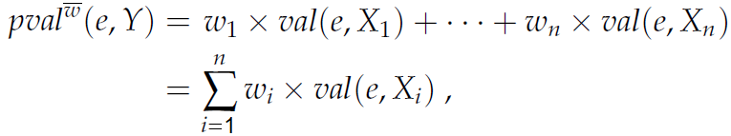
Linear Regression and Classification
Suppose the input features are X₁, . . . ,X_{n}. A linear function of these features is a function of the form:
where = w₁ , . . . , w_{n} is a tuple of weights.
Consider only one target, Y. Suppose a set E of examples exists, where each example e ∈ E has values val(e, X_{i}) for feature X_{i} and has an observed value val(e, Y). The predicted value is thus

Slide 61
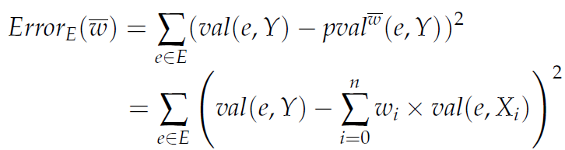
Linear Regression and Classification
The sum-of-squares error on examples E for target Y is
In this linear case, the weights that minimize the error can be computed analytically.

Slide 62
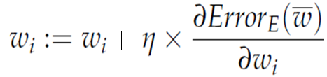
Linear Regression and Classification
Gradient descent is an iterative method to find the minimum of a function (gradient descent will be very clear from the perceptron learning section).
Gradient descent starts with an initial set of weights; in each step, it decreases each weight in proportion to its partial derivative:
where η, the gradient descent step size, is called the learning rate. The learning rate, as well as the features and the data, is given as input to the learning algorithm. The partial derivative specifies how much a small change in the weight would change the error.

Slide 63
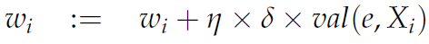
Linear Regression and Classification
Consider minimizing the sum-of-squares error. The error is a sum over the examples. The partial derivative of a sum is the sum of the partial For each example e, let δ = val(e, Y) − pval^{w}(e, Y) = error. Thus, each example e updates each weight w_{i}:
Algorithm, LinearLearner(X, Y, E, η), for learning a linear function for minimizing the sum-of-squares error (SOSE).

Slide 64
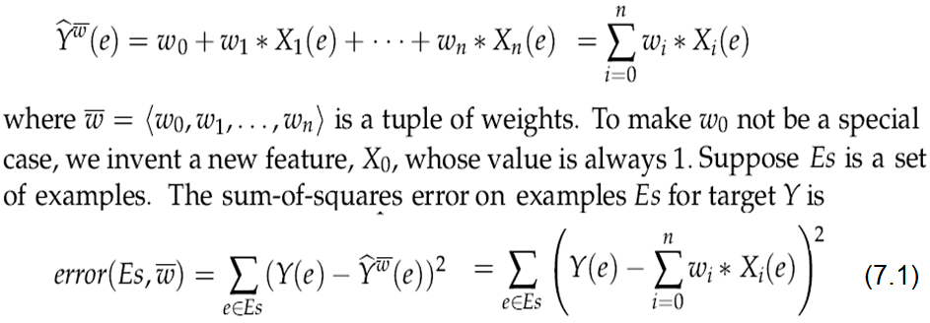
Linear Regression and Classification
Linear regression is the problem of fitting a linear function to a set of training examples, in which the input and target features are numeric.
Suppose the input features, X₁, . . . ,X_{n}, are all numeric and there is a single target feature Y. A linear function of the input features is a function of the form

Slide 65
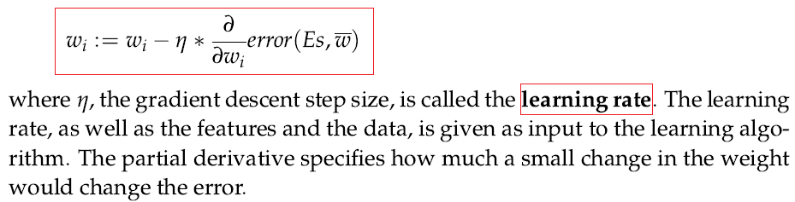
Linear Regression and Classification
Gradient descent is an iterative method to find the minimum of a function.
Gradient descent for minimizing error starts with an initial set of weights; in each step, it decreases each weight in proportion to its partial derivative:

Slide 66
Linear Regression and Classification
The backpropagation keeps changing the neuron weights until there is the most significant error reduction by an amount known as the learning rate (α).
Learning rate is a scalar parameter used to set the rate of adjustments to reduce the errors faster.
It is used to adjust weights and bias in the backpropagation process.
The higher the learning rate, the faster the algorithm will reduce the errors and the quicker the training process.

Slide 67
Linear Regression and Classification
Figure 7.8 gives an algorithm, Linear learner(X_{s}, Y, E_{s}, η), for learning the weights of a linear function that minimize the SOSE.
This algorithm returns a function that makes predictions on examples.
Termination is usually after some number of steps, when the error is small or when the changes get small.
Updating the weights after each example does not strictly implement gradient descent because the weights are changing between examples.
To implement gradient descent, we should save up all of the changes and update the weights after all of the examples have been processed.
The algorithm presented in Figure 7.8 is called incremental gradient descent because the weights change while it iterates through the examples

Slide 68
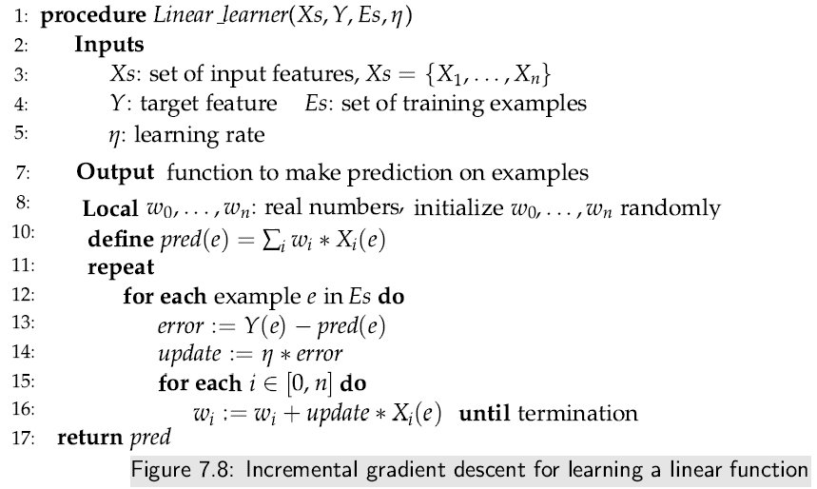
Linear Regression and Classification

Slide 69
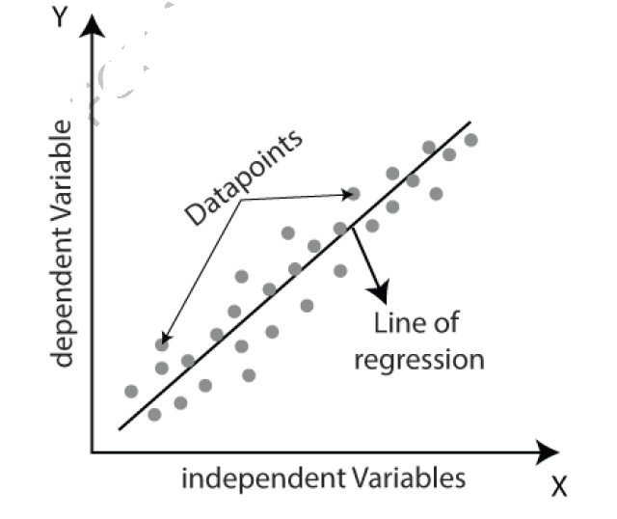
Linear Regression
Linear regression is a supervised learning algorithm used for predictive modeling
Linear regression predicts a variable's value based on another variable's value.
The variable you want to predict is called the dependent variable.
The variable you are using to predict the other variable's value is called the independent variable.
Linear regression predicts a dependent variable (y) based on the given independent variable (x). Hence, the name is linear regression.

Slide 70
Linear Regression
Linear regression is used to model the relationship between a dependent variable (also called the response variable) and one or more independent variables (also called predictors or features) that are assumed to be linearly related (as a straight line).
Input and output of a simple linear regression are:
Input:
Independent variable x
Dependent variable y
Prediction output: y’ = a + bx
a = Intercept of the line
b = slop or linear regression coefficient of the line

Slide 71
Linear Regression Steps
Here is the algorithm for a simple linear regression:
Set labeled dataset with marked input (x) and output (y).
Calculate the corresponding xy, x², and y² of each row of dataset.
Calculate Σx, Σy, Σ(xy), Σx², and Σy²
Calculate the intercept a using the following formula: a = [((Σy)*(Σx²)) – (Σx *Σ(xy))] / [(n*Σx²) – (Σx)²], where n is the number of data samples
Calculate the slop or coefficient b using the formula: b = [(n*Σxy) – (Σx * Σy)] / [(n*Σx²) – (Σx)²], where n is the number of data samples
Insert the values of a and b into the prediction output y’ = a + bx
If x is a new input (meaning it is not from the dataset), its output y’ is generated.

Slide 72
Linear Regression
Here is an example of a simple linear regression problem:
Suppose we want to predict a house’s price y based on its size x (in square feet, SqFt).
We have the house-price.csv dataset of houses with their corresponding sizes and prices.
The goal is to learn a linear regression model that can predict the price of a new house, given its size.
To solve this problem, we can use the following linear regression equation: y’ = bx + a.
where y is the dependent variable (price), x is the independent variable (size in SqFt), b is the slope (the change in y per unit change in x), and a is the y-intercept (the value of y when x is 0).
Predict the house price when x = 2000 Square feet, predicted price y’: 130361.50657

Slide 73
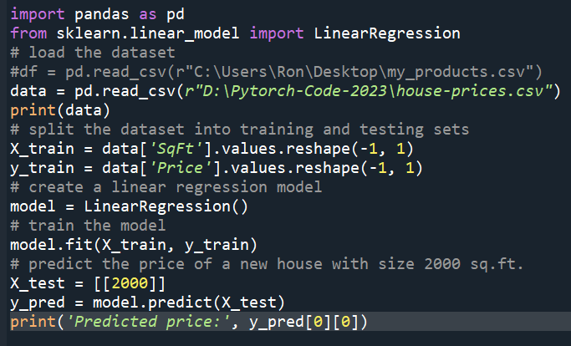
Linear Regression

Slide 74
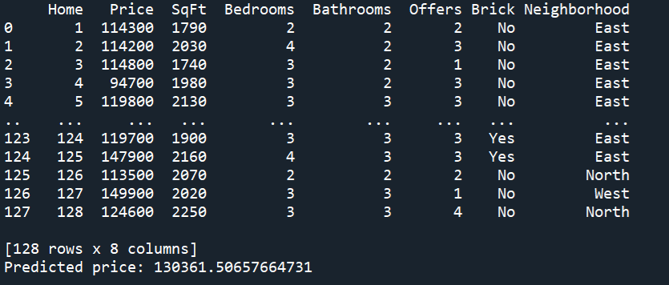
Linear Regression

Slide 75
Multiple Linear Regression
Logistic Regression is a supervised learning method used to analyze the relationship between a categorical dependent variable and more than one independent variable.
It is commonly used for classification tasks, such as predicting whether a customer will buy a product or a patient will be diagnosed with a disease.
The logistic regression model is a generalized linear model that uses a logistic function to transform the linear regression output into a probability value between 0 and 1.
This probability value is then used to classify the input into two possible classes: ‘ yes' or ‘no,’ 'spam' or 'not spam,’ etc.

Slide 76
Multiple Linear Regression
Home work
Predict the value of BMI (Body Mass Index) from the Height and Weight of a person using logistic regression.
Download “Gender-Height-Weight-BMI” CSV dataset from https://www.kaggle.com/datasets/yersever/500-person-gender-height-weight-bodymassindex/
Use ideas from:
https://www.statology.org/multiple-linear-regression-by-hand/

Slide 77
Linear Regression and Classification
The algorithm presented in Figure 7.8 is called incremental gradient descent because the weights change while iterates through the examples.
If the training examples are selected at random, this is called stochastic gradient descent (SGD).
These incremental methods have cheaper steps than gradient descent and typically become more accurate when saving all the changes to the end of the examples.
However, it is not guaranteed to converge as individual examples can move the weights away from the minimum.

Slide 78
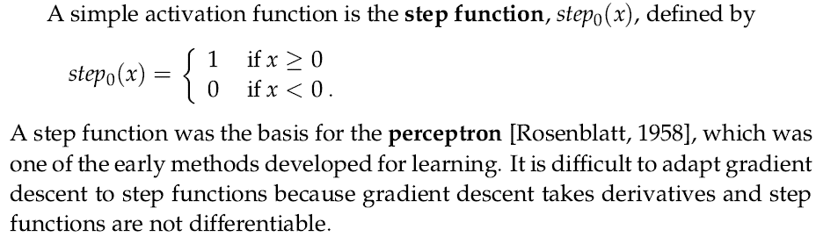
Activation Functions
If the activation is (almost everywhere) differentiable, gradient descent can be used to update the weights.
The step size might need to converge to zero to guarantee convergence.

Slide 79
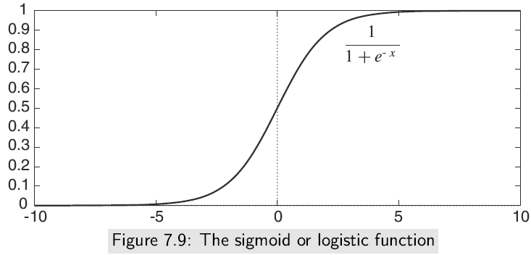
Activation Functions
One differentiable activation function is the sigmoid or logistic function: This function, depicted in Figure 7.9, squashes the real line into the interval (0, 1), which is appropriate for classification because we would never want to make a prediction of greater than 1 or less than 0.

Slide 80
Underfitting and Overfitting
Overfitting occurs when a model is trained too well on the training data and performs poorly on new, unseen data.
The factors determining how well a machine learning algorithm will perform are its ability to
Make the training error small
Make the gap between training and test error small.
These two factors correspond to the two central challenges in machine learning: Underfitting and Overfitting

Slide 81
Underfitting and Overfitting
Underﬁtting: Underfitting occurs when a statistical model cannot adequately capture the underlying structure of the data.
Underfitting refers to a model that neither trains the data nor generalizes to new data.
An underfit machine learning model is unsuitable and will be obvious as it will perform poorly on the training data.
Overfitting: overfitting occurs if the model shows low bias but high variance (variance = trained data – test data):
Such models are also responsible for predicting poor results due to their complexity.
Overfitting happens when a model learns the detail and noise in the training data to the extent that it negatively impacts the model’s performance on new data. Overfitting is more likely with nonparametric and nonlinear models with more flexibility when learning a target function.

Slide 82
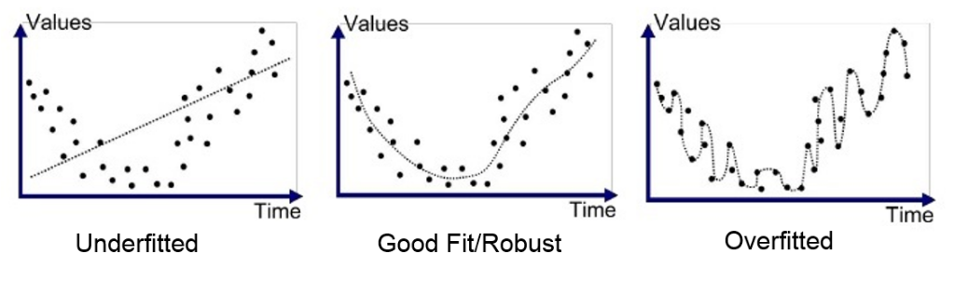
Underfitting and Overfitting
Underﬁtting occurs when the model is not able to obtain a suﬃciently low error value on the training set.
Overﬁtting occurs when the gap between the training and test errors is too large.
Figure 3.1 Underfitting, appropriate-fitting and overfitting events

Slide 83
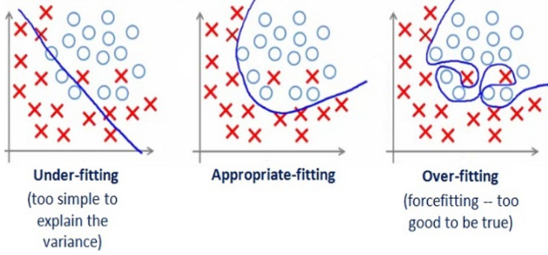
Underfitting and Overfitting
Here comes the concept of overfitting and underfitting training issues. Figure 3.1 shows overfitting, appropriate fitting and underfitting situations.
Figure 3.2 Underfitting, appropriate-fitting and overfitting training events

Slide 84
Underfitting and Overfitting
From figure 3.2, by looking at the graph on the left side we can predict that the line does not cover all the points. Such model tend to cause underfitting of data, it also called High Bias.
Where as the graph on right side, shows the predicted line covers all the points in graph.
Such model are also responsible to predict poor result due to its complexity. Such model tend to cause overfitting of data (it is also called High Variance).
In such condition you can also think that it’s a good graph which cover all the points.
But that’s not actually true, the predicted line into the graph covers all points which are noise and outlier.

Slide 85
Cross-validation https://www.geeksforgeeks.org/cross-validation-machine-learning/
Cross-validation is a machine learning technique to evaluate a model's performance on unseen data (test data).
It involves dividing the training data into multiple folds or subsets, using one of these folds as a validation and training set.
This process is repeated using a different fold as the validation set.
Finally, the results from each validation step are averaged to produce a more robust estimate of the model’s performance.
The primary purpose of cross-validation is to prevent overfitting
it occurs when a model is trained too well on the training data and performs poorly on new, unseen data.

Slide 86
Methods of Cross-validation https://www.geeksforgeeks.org/cross-validation-machine-learning/
Simple Validation:
In this method, we train 50% of the given data set; the rest, 50%, is used for testing purposes.
The major drawback of this validation method is that we perform training on 50% of the dataset;
It may be possible that the remaining 50% of the data contains some important information we left while training our model, i.e., higher bias.

Slide 87
Methods of Cross-validation https://www.geeksforgeeks.org/cross-validation-machine-learning/
K-Fold Cross Validation:
In this method, we split the training data set into k subsets (known as folds), then we perform training on all the subsets but leave one(k-1) subset to evaluate the trained model.
In this method, we iterate k times with a different subset reserved for testing purposes each time.

Slide 88
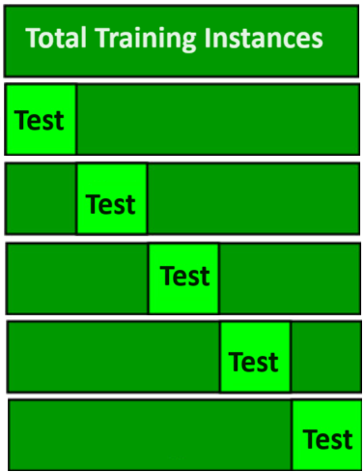
K-fold Cross-validation https://www.geeksforgeeks.org/cross-validation-machine-learning/
The diagram below shows an example of the training and evaluation subsets generated in k-fold cross-validation
Here, we have 25 training instances, and k is 5, which means there are 5 test instances at each iteration.

Slide 89
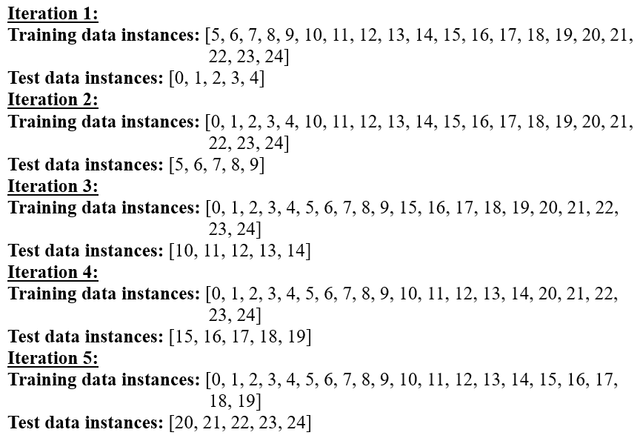
The sample 25 training instances are as follows:
[0, 1, 2, 3, 4, 5, 6, 7, 8, 9, 10, 11, 12, 13, 14, 15, 16, 17, 18, 19, 20, 21, 22, 23, 24]

Slide 90
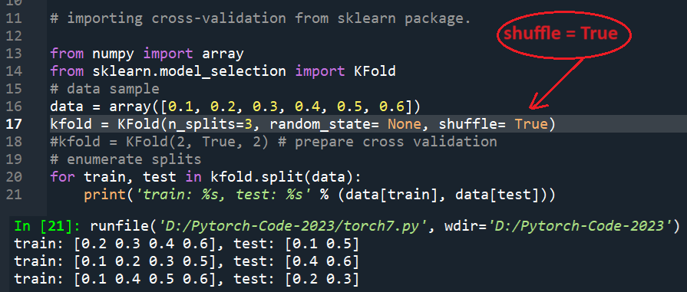
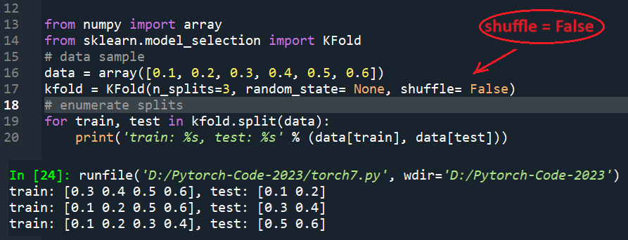
https://machinelearningmastery.com/k-fold-cross-validation/

Slide 91
K-fold Cross-validation https://www.geeksforgeeks.org/cross-validation-machine-learning/
Advantages of k-fold cross-validation:
More accurate estimate of out-of-sample accuracy.
More “efficient” use of data, as every observation is used for training and testing.
Preventing Overfitting: Cross-validation helps to prevent overfitting by providing a more robust estimate of the model’s performance on unseen data.
Model Selection: Cross-validation can be used to compare different models and select the one that performs the best on average.
Hyperparameter tuning: Cross-validation can be used to optimize the hyperparameters of a model, such as the regularization parameter, by selecting the values that result in the best performance on the validation set.
Data Efficient: Cross-validation allows the use of all the available data for training and validation, making it a more data-efficient method than traditional validation techniques.

Slide 92
K-fold Cross-validation https://www.geeksforgeeks.org/cross-validation-machine-learning/
Disadvantages of cross-validation:
Computationally Expensive: Cross-validation can be computationally expensive, especially when the number of folds is large, or the model is complex and requires a long time to train.
Bias-Variance Tradeoff: The choice of the number of folds in cross-validation can impact the bias-variance tradeoff, i.e., too few folds may result in high variance, while too many folds may result in high bias.

